Slide 1
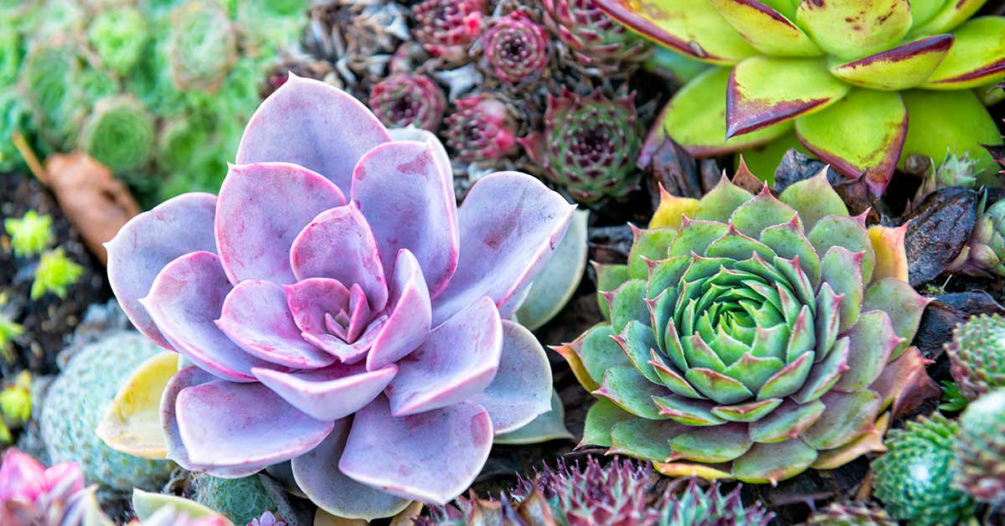
Planting for Success
a mindful and reflective activity…

Slide 2
ACKNOWLEDGEMENT
The Planting for Success resource has been created by the Collaborative Project Officers of:
Southern Fleurieu and KI Positive Ageing Taskforce
Riverland Mallee Coorong Taskforce
Hills Positive Ageing Project
Southern Services Reform Group
This resource was specifically designed and developed for the ‘Same Same but Different’ Regional Reform Forum held on 20 May 2022 at The Secret Garden, Marion Hotel, South Australia.
This PowerPoint supports the Planting for Success activity script, refer to the script for further details.

Slide 3
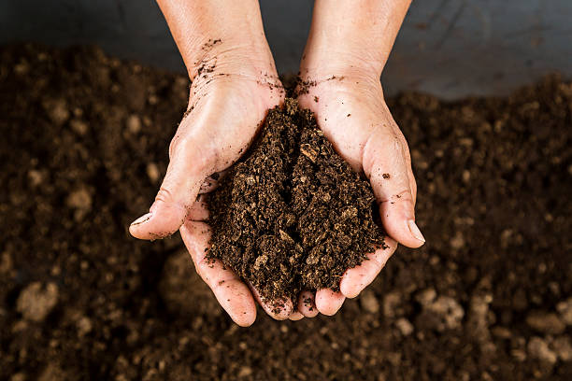
workforce
Funding
Recognition / celebrating achievements
Name
SERVICES
Attractiveness & Diversity
Branding
Resources
ORGANISATIONAL FRAMEWORK
Foundational elements
Workplace culture
Drainage / flow through
PPE TOOLS

